Slide 1
Subject : Data Structures & Algorithms
Lecture : 01
In the Name of Allah the Most Beneficent the Most Merciful

Slide 2
What is Data Structure?
In computer science, a data structure is a particular way of storing and organizing data in a computer so that it can be used efficiently. Different kinds of data structures are suited to different kinds of applications, and some are highly specialized to specific tasks.
The basic types of data structures include:
Files, lists, arrays, records, trees, tables, graphs
Each of these basic structures has many variations and allows different operations to be performed on the data.

Slide 3
What is Algorithm?
An algorithm is a generic, step-by-step list of instructions for solving a problem. It is a method for solving any instance of the problem such that given a particular input, the algorithm produces the desired result.
A program, on the other hand, is an algorithm that has been encoded into some programming language. There may be many programs for the same algorithm, depending on the programmer and the programming language being used.

Slide 4
Need for Data Structures
Data structures organize data ⇒ more efficient programs.
More powerful computers ⇒ more complex applications.
More complex applications demand more calculations.

Slide 5
Organizing Data
Any organization for a collection of records that can be searched, processed in any order, or modified.
The choice of data structure and algorithm can make the difference between a program running in a few seconds or many days.

Slide 6
Efficiency
A solution is said to be efficient if it solves the problem within its resource constraints.
  Space
  Time
The cost of a solution is the amount of resources that the solution consumes.

Slide 7
Selecting a Data Structure
Select a data structure as follows:
Analyze the problem to determine the resource constraints a solution must meet.
Determine the basic operations that must be supported. Quantify the resource constraints for each operation.
Select the data structure that best meets these requirements.

Slide 8
Some Questions to Ask
Are all data inserted into the data structure at the beginning, or are insertions interspersed with other operations?
Can data be deleted?
Are all data processed in some well-defined order, or is random access allowed?

Slide 9
Data Structure Philosophy
Each data structure has costs and benefits.
Rarely is one data structure better than another in all situations.
A data structure requires:
  space for each data item it stores,
  time to perform each basic operation,
  programming effort.

Slide 10
Memory Organization
The memory that communicates directly with CPU is called main memory.
Devices that provides backup storage are called secondary memory.
Only program and data currently needed by the processor resides in main memory.
All other information is stored in auxiliary (secondary) memory and transferred to main memory when needed.

Slide 11
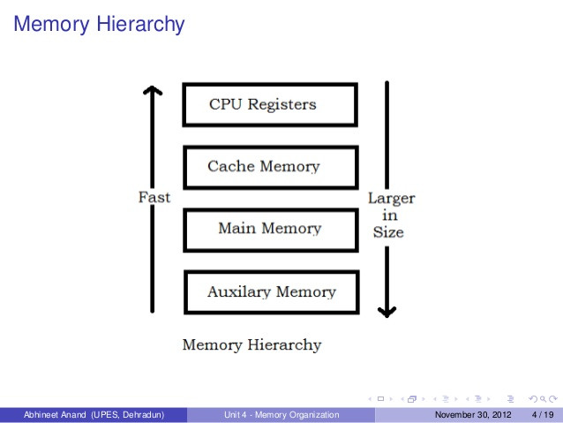
Memory Organization…

Slide 12
Memory Organization…
Memory is divided into fixed-size units called cells, and each cell is associated with unique identifier called an address. These addresses are the unsigned integers 0, 1, 2,……MAX.
All access to memory are to a specified address, and we must always fetch or store complete cell-that is, all the bits in that cell. The cell is the minimum unit of access.
The time it takes to fetch or store the contents of a cell is the same for all the cells in memory.

Slide 13
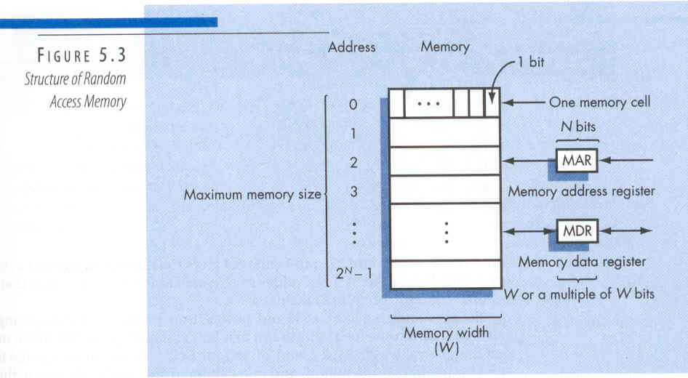
Memory Organization…

Slide 14
Goals of this Course
Reinforce the concept that costs and benefits exist for every data structure.
Learn the commonly used data structures.
  These form a programmer's basic data structure “toolkit”.
Understand how to measure the cost of a data structure or program.
  These techniques also allow you to judge the merits of new data structures that you or others might invent.

Slide 15
The END
Question and Answer

